Slide 1
Beyond the dashboard: R for value added insights
Dr. Nic Farthing MPhys
Senior Public Health Intelligence Manager Midlands Regional Team
Nicola.farthing2@nhs.net
21/11/2024
Notes:
Standard title slide

Slide 2

Accurate, reproducible and appropriate analysis is the only way we can systematically drive improvement in healthcare.
Notes:
Plain slide with subhead and bullets

Slide 3

Can you just make me a dashboard with all the data in it?

Slide 4
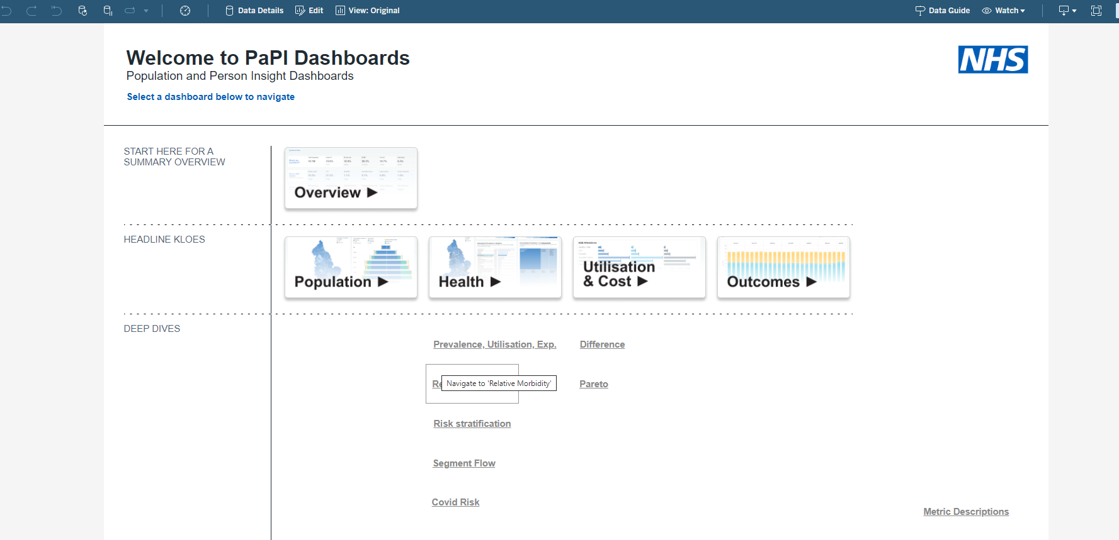
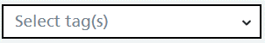

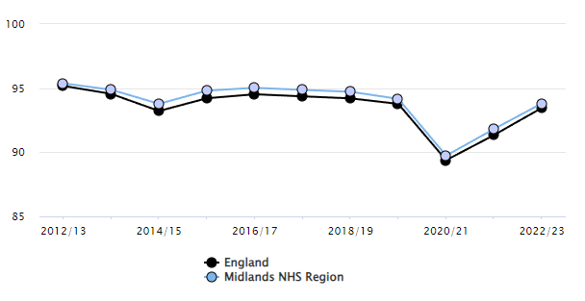
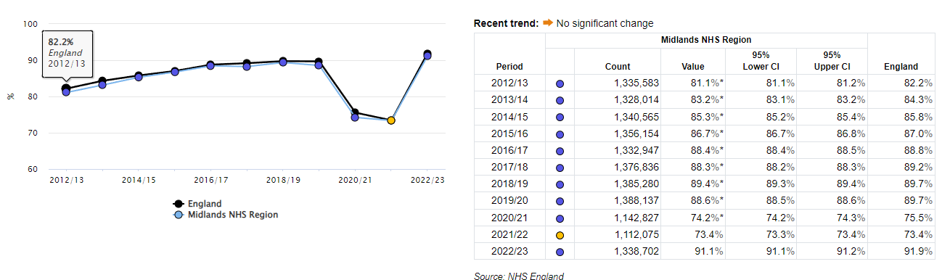
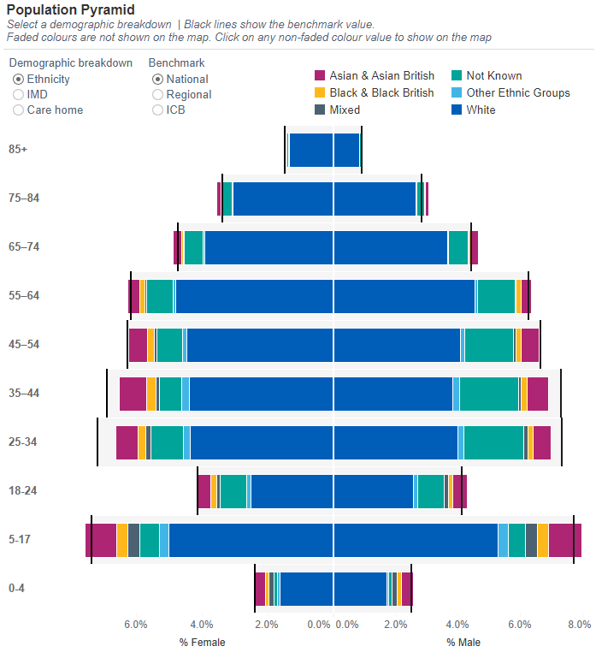
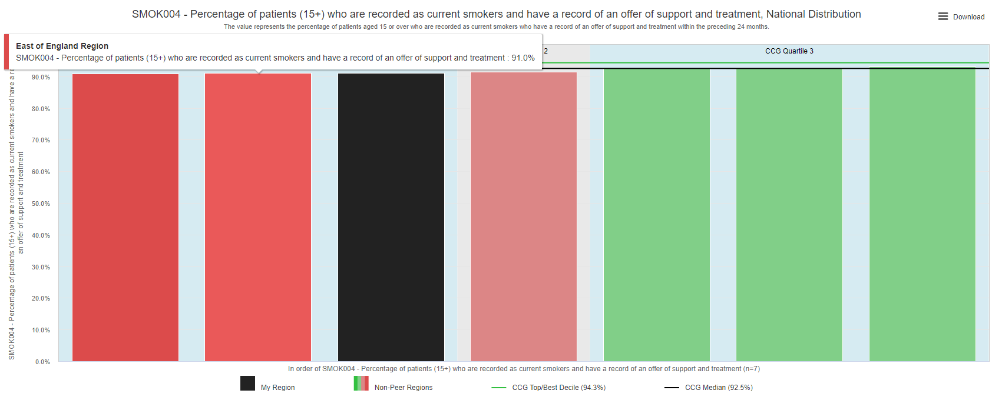
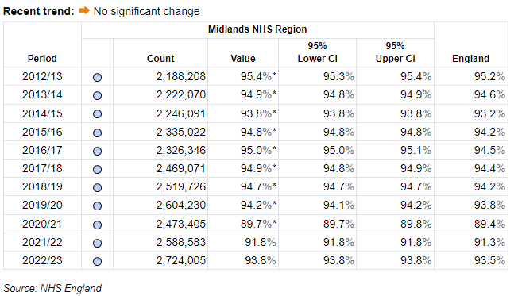
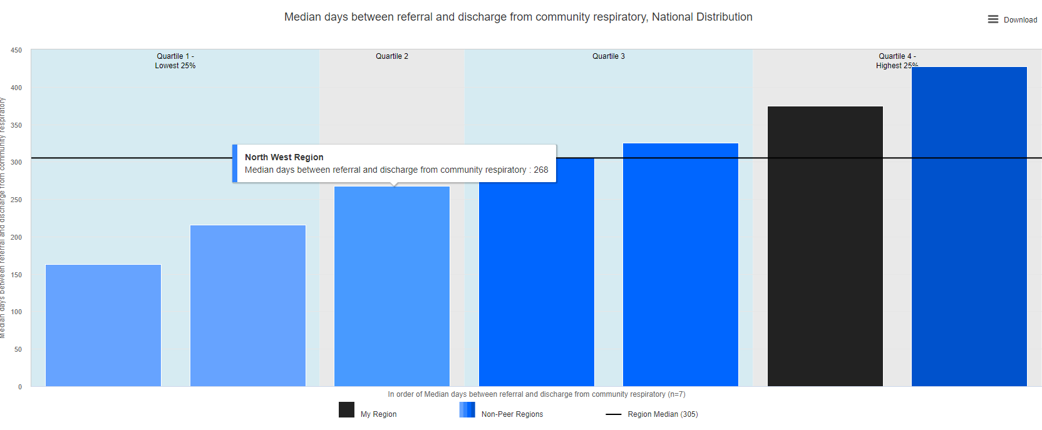
“I want to understand the health inequalities smoking services and lung cancers”
Nic’s New Smoking Dashboard-
Select Area
Imaginary area

Slide 5
Nic’s New Smoking Dashboard- Midlands
Smoking data by ethnicity
Smoking data by sub-ICB
Smoking data by deprivation
Mixed and Other ethnic categories are not being offered the services but its ok because they contribute to a small percentage of lung cancers?
Offering smoking cessation services is less effective at stopping lung cancers in Asian/ Asian British and Black/ Black British populations?

Slide 6
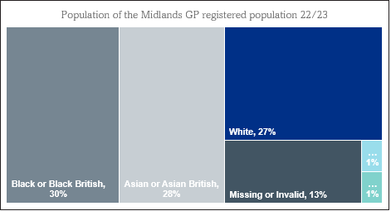
?
Is some other data missing?
Nic’s New Smoking Dashboard- Midlands
Smoking data by ethnicity
Smoking data by sub-ICB
Smoking data by deprivation
A smaller percentage of smokers with non-White ethnicities are offered services.

Slide 7
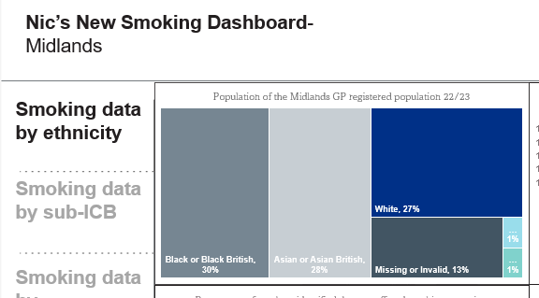
1. Group relevant data together
Makes the data less overwhelming.
It draws the user’s attention towards other contextual data that is useful in telling the story.

Slide 8
2. Story telling with the data
Start with an overview and then drill down into key areas.
Try to show how one trend in some data might lead to a trend in another.
Think about whether you can take that further and include predictions or opportunities for improvement.

Slide 9
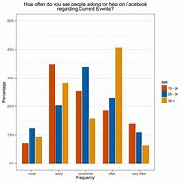
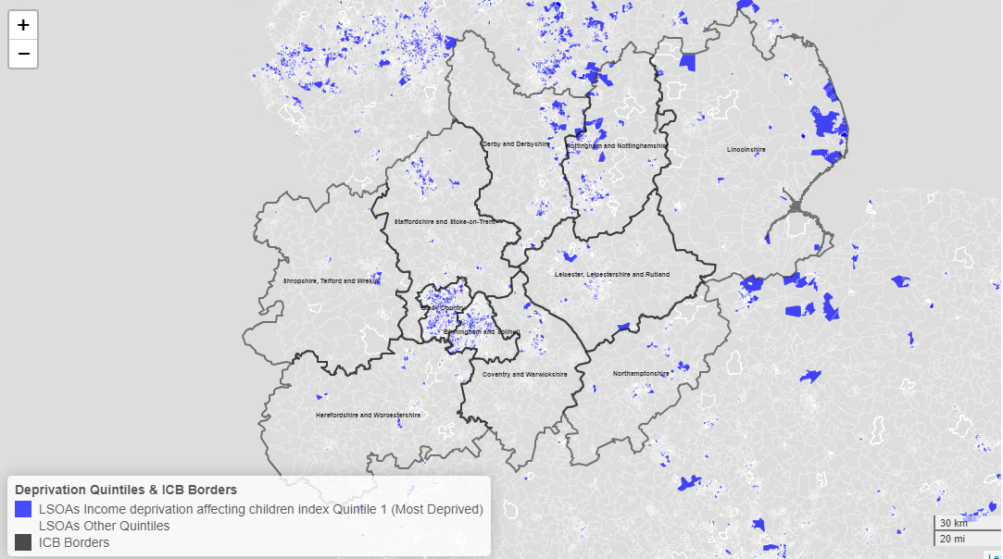
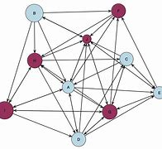
3. What visual tells the story the best?
Think about what makes the data the easiest to interpret. Maybe it’s a graph – maybe it’s a map (leaflet), a network plot (igraph), a flow chart (diagramR), ….
Referred to in-house service
Seen by in-house service
Set a quit date
Quit smoking
13%
Identified in hospital
57%
Yes
87%
Yes
No
Yes
100%
Yes
100%
No
43%
1,235
7% of the smokers identified in hospital quit smoking
No
0%
No
0%

Slide 10
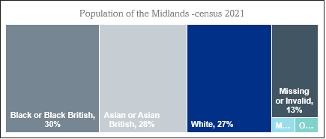
4. Don’t be afraid of text
Nic’s New Smoking Dashboard- Midlands
Smoking data by ethnicity
GP data shows that more than two thirds of the are population has a non-white ethnicity – although there is a data quality concern with almost 1 in 7 records missing a valid ethnicity code.
Across all ethnicities 15% are ever smokers
Smoking data by sub-ICB
Smoking data by deprivation
Non-White ethnicities are LESS like to be offered smoking cessation services and MORE likely to develop lung cancer.

Slide 11

5. Have we questioned ourselves?
Is this the right analysis?
Do we need to do novel analysis?
Have we been clear on DQ caveats?
More than transparent – have we drawn attention to methodology?
Is this the right data to be measuring/ presenting?

Slide 12
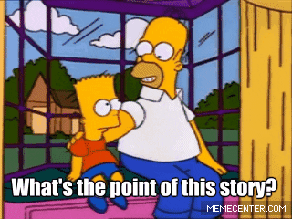
As the providers of data/analysis, we hold a lot of power over how that data is interpreted.
Imagine you’re super busy, maybe not that comfortable with data and you don’t have all the contextual information – what messages are you likely to take from the data?
Now think if there’s any changes you can make to your dashboard to make sure they’re taking the right ones.

Slide 13
“What gets measured gets managed — even when it’s pointless to measure and manage it, and even if it harms the purpose of the organisation to do so”.
Dysfunctional Consequences of Performance Measurements on JSTOR – V.F Ridgeway

Slide 14
End slide
RECRUITING NOW
B7 Public Health Apprentice
Midlands
nicola.farthing2@nhs.net

